Slide 1



King county, WA Housing market
Linear regression-based pricing model
By
Chamila C. Dharmawardhana

Slide 2

Project objectives
Realtor King LLC desires to have a data driven pricing model for King county Washington.
What is the current price distribution ?
What factors affects the value of a house ?
How does the price change over time ?

Slide 3
Data sources and modeling constraints
Data Sources
King county housing price data from 2014 to 2015 year.
Model assumptions
Time sample: 2014 – 2015.
Region : King county, WA
Features: 19 distinct features are considered with Price as the target
Model: multivariate linear regression may be suitable for this study

Slide 4
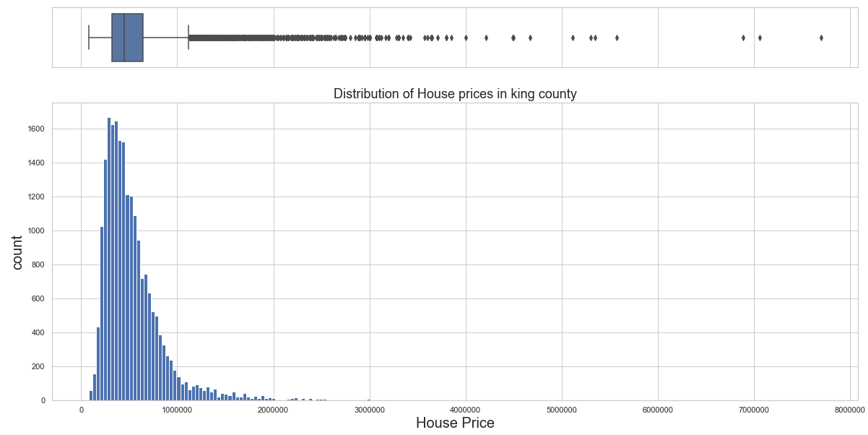
Price distribution
More than 99% of the houses are less than $ 2 million

Slide 5
The dataset
Price = ?
Discrete variables |  | Continuous variables
date sold | Year built | Living Area | Lot Area
Year renovated | # of bedrooms | Living area of 15 neighbors | Lot area of 15 Neighbors
# of bathrooms | # of floors | Area above ground | Area basement
Is waterfront property ? | View quality
condition | grade
zipcode |  | Latitude | Longitude
The resultant model is expected to pick the most essential features for house prediction out of these 19

Slide 6
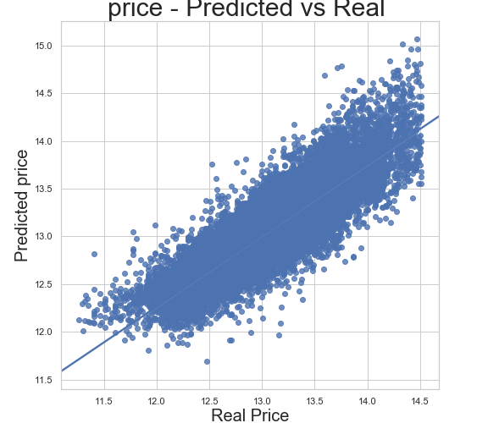
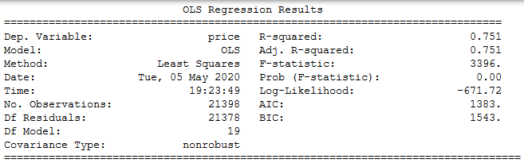
Comparison of predicted vs real
Selected features from feature engineering
zipcode | lat | long
bedrooms | bathrooms | floors
grade | condition | waterfront
yr_built | season | sqft_living
sqft_basement | sqft_lot | sqft_living15

Slide 7
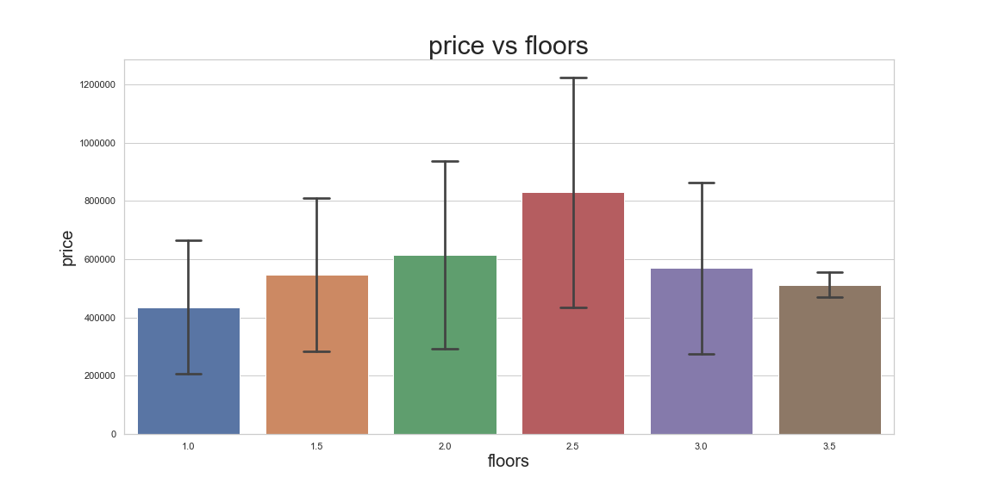
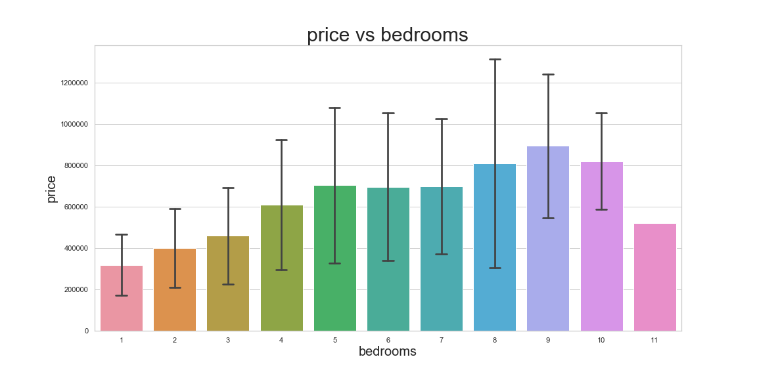
Does the size matter ?
Large variance
Mean price is linear up to 2 floors
Mean price is linear up to 5 bedrooms

Slide 8
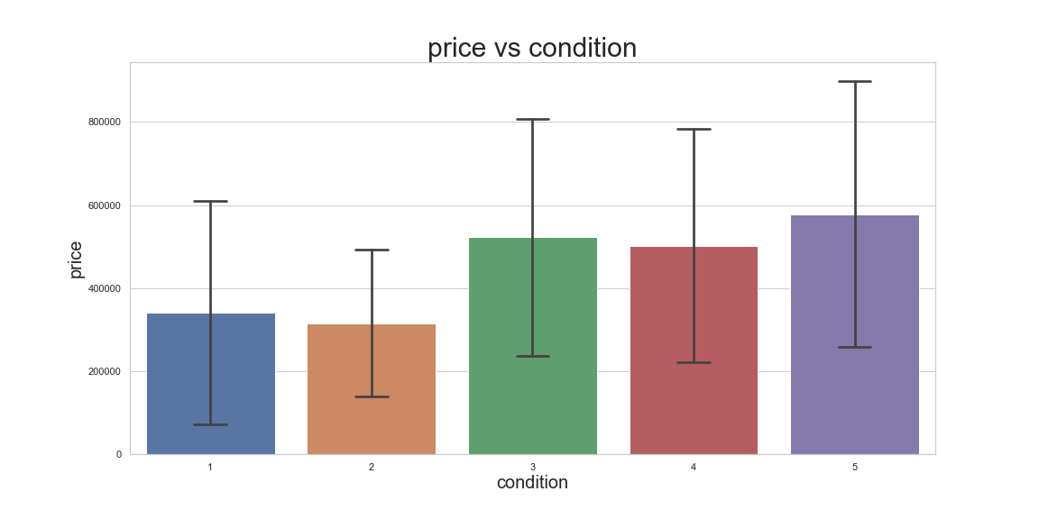
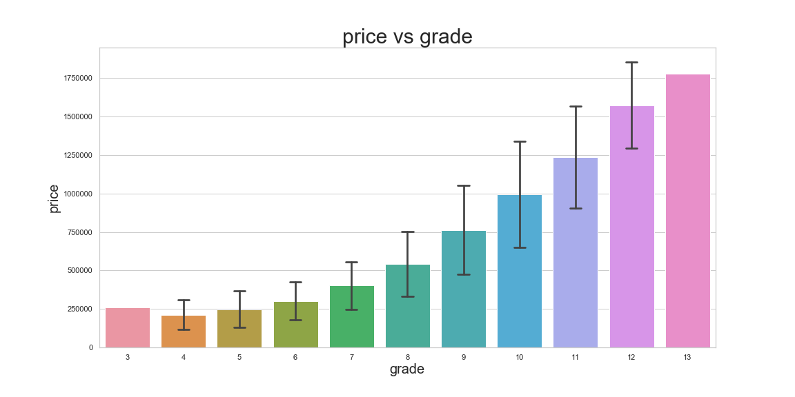
Does the look and quality matter ?
High variance
Condition > 3 will increase property value
Grade has a 2nd order polynomial relationship with price

Slide 9
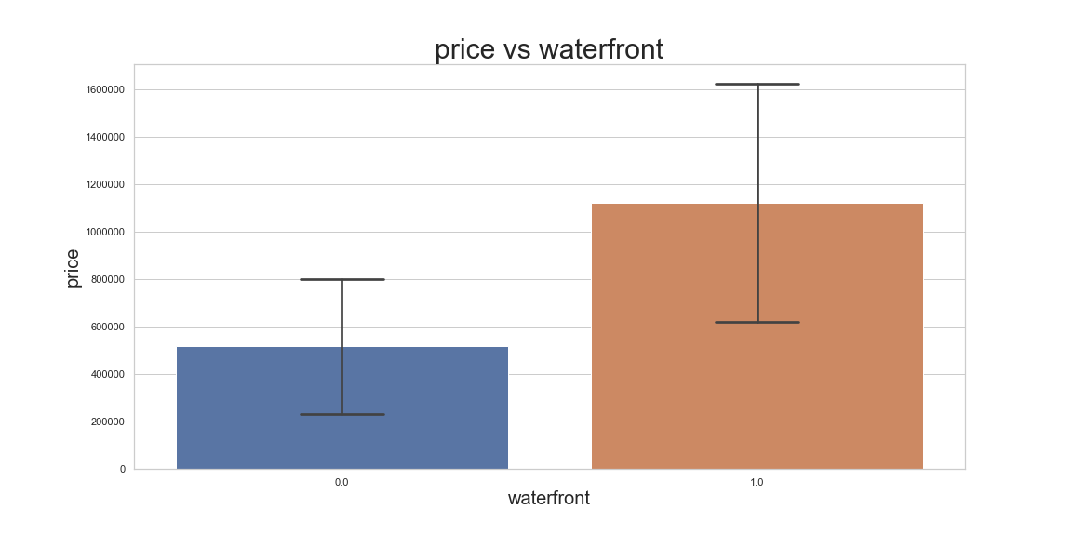
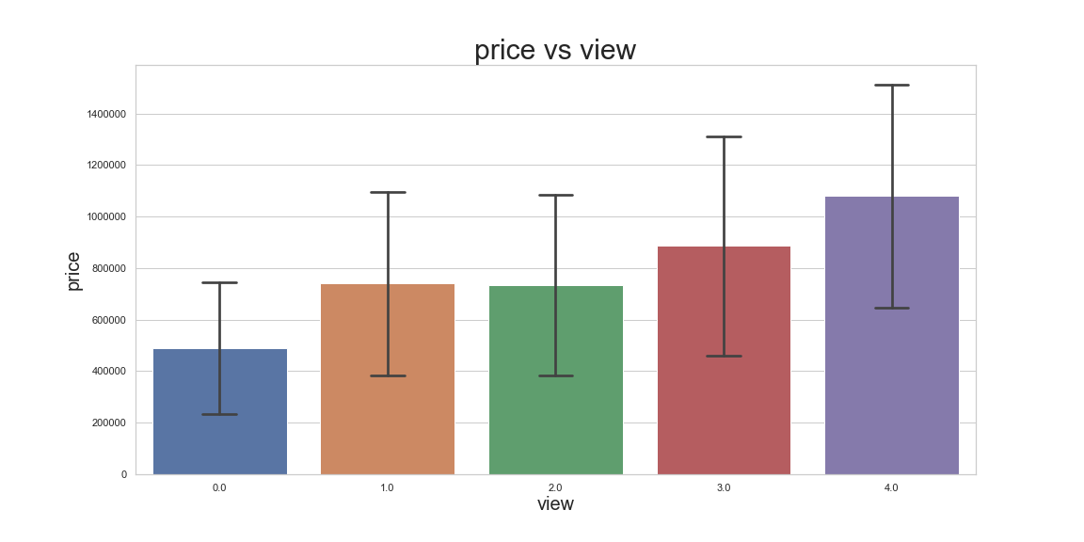
Does the look matter ?
Average price seems to increase for waterfront properties
Larger view seem to increase the property value

Slide 10
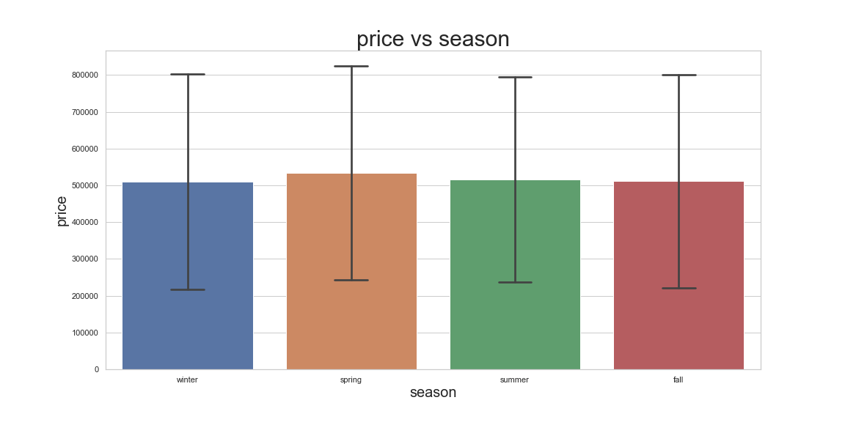
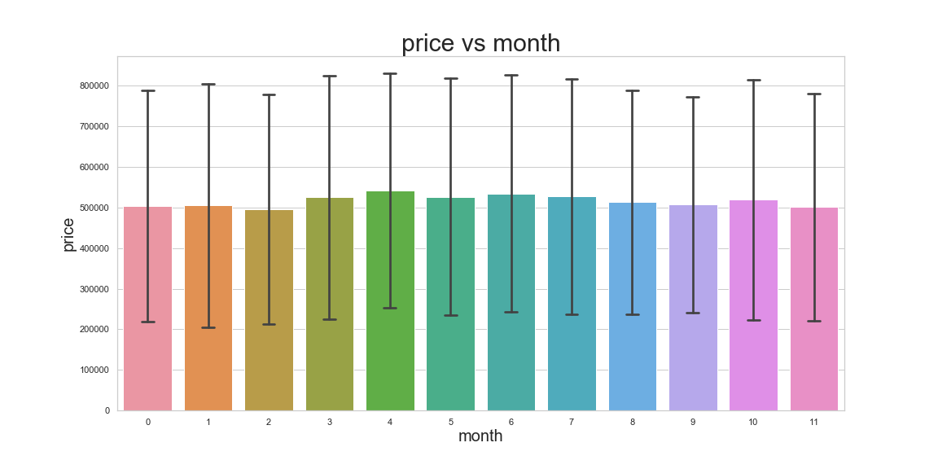
Right time to sell ? Season or the sale date does not appear to affect the price

Slide 11
Conclusions
Biggest factors for the current linear regression model are grade, sqft_living, sqft_living15, latitude and bedrooms
Grade has a 2nd order correlation with mean price
There’s almost no affect on sale date
For general houses 1.25 bathrooms/bedroom is the optimal
Bedrooms correlate linearly up to 5 bedrooms/house

Slide 12
Future work
Due to lack of data yr_renovated had to be dropped. Would be good to web scrape for this data.
One year of data is not enough for proper analysis.
Further statistical tests could’ve made the model better.
More data sources can be used.
Other ML methods might be tried for more accurate modelling.

Slide 13

Acknowledgement
Amber Yandow
Dara Paoletti
Prof. Pasan Edirisinghe
Thank you

